Slide 1
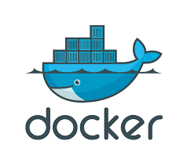
Sealingtech Lunch and Learn: Docker & Kubernetes
Markus Mabson
Daniel Lohin

Slide 2
Agenda:
Introduction to Docker and Kubernetes
Docker Overview
Docker lab
Kubernetes Overview
Kubernetes Lab
Intro to Calico and Kubernetes networking (time permitting)

Slide 3
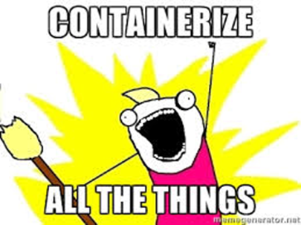
Introduction to Docker and Kubernetes
Rapid Deployment, Isolated Environment, Developer productivity.

Slide 4
What is Docker?
Docker, is an open-source project that automates the deployments of applications inside of user created containers by providing an added layer of abstraction and automation that has the capability to perform operating system level virtualization.

Slide 5
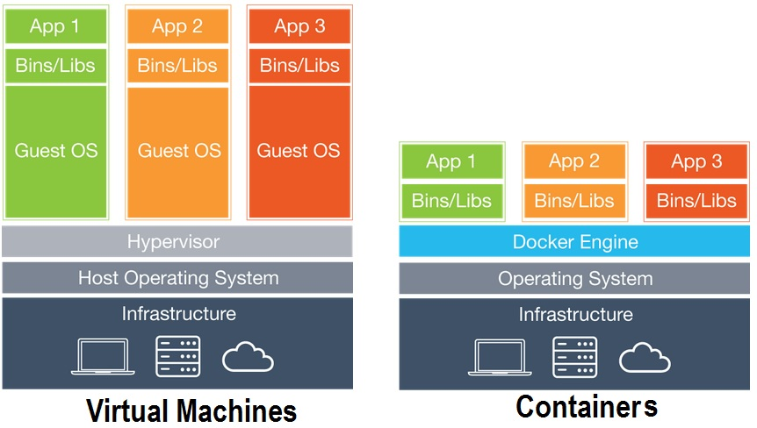
What’s the Difference?

Slide 6
Kubernetes
A method of orchestrating containers across cloud type environments
Developed by Google based on how they internally managed their infrastructure
Focuses on building highly scalable systems using commodity hardware
Orchestrates the networking, storage and compute using ”infrastructure as code” design

Slide 7
What is Kubernetes
Kubernetes acts as an abstraction to the infrastructure so that applications don’t need to understand the details of what it looks like
Kubernetes is highly extensible with plugins and every cluster will look different, but generally that is ok because Kubernetes solves the details for you. As long the the plugins and clusters follow a certain set of rules, the underlying details not longer matter.
Kubernetes is designed to deploy and manage the lifecycle of containers across a number of hosts

Slide 8
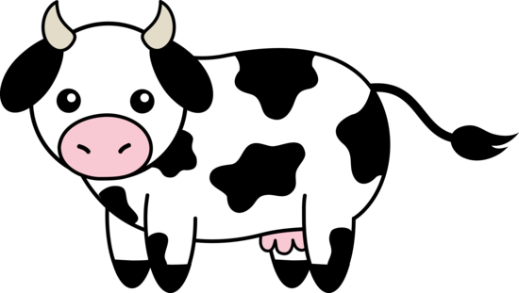

Cattle vs Pets
Phrase used a lot in the Kubernetes and Container communities
Pets are servers, Containers are cattle
Pets we care for, we feed, we take them to the doctors when they are sick
Cattle we use them, and when they are no longer of use we shoot them
THIS IS HOW YOU NEED TO START THINKING!

Slide 9
Some core concepts of Devops
Docker and Kubernetes exist as technologies to enable Devops. Here are some key concepts:
Containers are cattle, not pets. Use them, shoot them and then move on
Fail fast – we will fail, but it is important that when we fail we can quickly revert back to a known state.
Continuous Integration - Deploy small changes more frequently
Shared environments – Dev, test, production should all be identical if not the same
Deployment should be as hands off as possible.

Slide 10
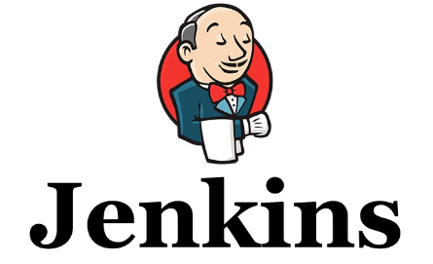
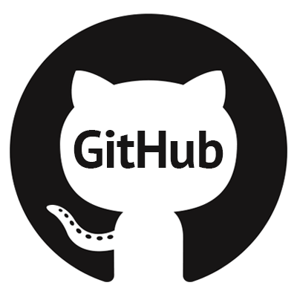
Devops process with Kubernetes
Dev
Test
Prod
Build applications (if necessary)
Build Docker containers and push to repository
Build Kubernetes Yaml files
Deploy to development area of cluster
Automated testing
Preliminary testing
Deploy Kubernetes YAMLs into test area of cluster
Test product
Deploy Kubernetes YAMLs into production area of cluster
Automated build and testing
Version management and CM

Slide 11
What does this solve?
Configuration management – Think of how many times in your IT career you decided that it was best to start over with a server?
Upgrade path craziness and testing – oh you went from 1.11 to 1.13, we didn’t test that why didn’t you install 1.12
Documentation hell – mounds of documentation that can be unclear, as well as operator error
Makes development, testing and production a highly repeatable operation – how many times did you find a bug in production because they were using some other piece of hardware or software that wasn’t in testing.

Slide 12

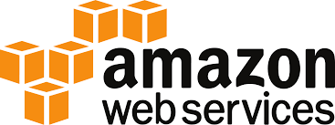



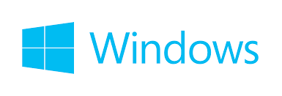
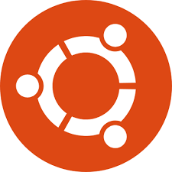
Supported Platforms

Slide 13
Who?
Everyone!
Work is front loaded as much on dev as possible
Operations will help developers integrate applications early on in the lifecyle instead of having software “thrown” over the fence
By the time it makes it to operations, deployment should simply be pressing a button
Operations can now focus on maintaining and monitoring the cluster and less time on deploying applications and figuring out how to make them work

Slide 14
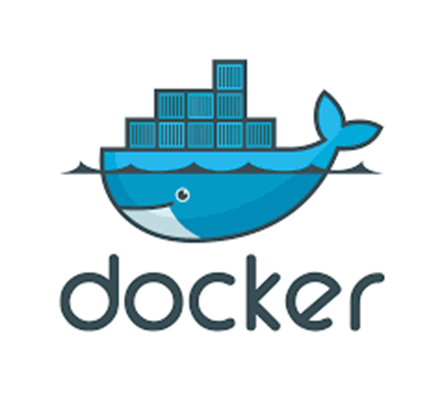
Docker
Containerize ALL the things

Slide 15
Docker basics
Image – The basis of a docker container, content at rest.
Container – An instance of an image.
Dockerfile – Text document that holds instructions to create an image
Engine – Executes commands for containers.
Registry – Centralized storage location, that can manage and distribute docker images
Control plane- Management plane for container as well as cluster orchestration

Slide 16
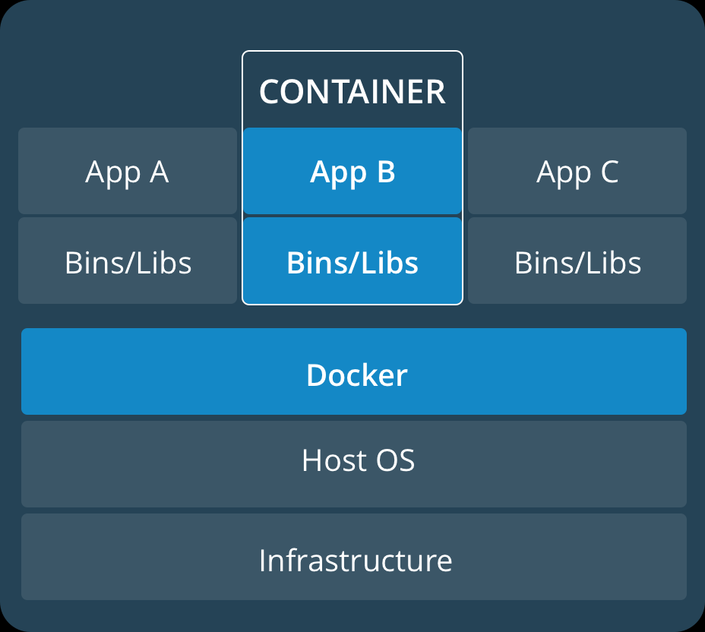
A Container?
Lightweight, stand-alone software that includes system tools, system libraries executable package.
Packaged software for development, shipment as well as deployment
Containers share the machine’s OS kernel
Containers are isolated using namespaces
PID
Networking
Mount Points
UID/GID
Limit processors and memory
And more!

Slide 17
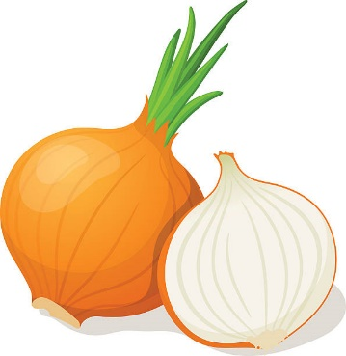
Dockerfile
A Dockerfile, is a text document that holds all the commands that a user could call on the command line to create an image.
Images generally just contain a single application and all the libraries that are needed to run that application
Like onions and Ogres, images have layers this consumes less space and allows for faster deployments
A lot of dockerfiles already exist for your common applications on Docker Hub!
Generally you will start with an image, extend the image with your customizations and create a new image.

Slide 18
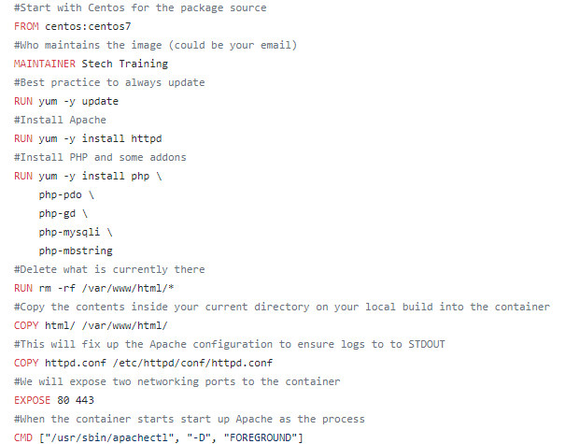
Sample Dockerfile
From centos:centos7 – This line will be the image to start from, this comes with some very basic tools like yum and most importantly you can no use Centos repositories for all your applications and libraries
Maintainer – who maintains the image (generally an email)
RUN commands- run these commands in order to build the image
COPY – we can copy files and directories from our current working directory into the directory structure of the container
EXPOSE – mostly used to document what ports will be used
CMD – This is the command that will be run when the container comes online

Slide 19
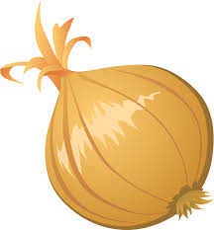
Layers
Docker containers are building blocks for many applications.
Each container consists of a writeable layer stacked on top of several other read-only layers.
Layers(intermediate images) are built when the commands in the Dockerfile are executed.
Once the container is created ($docker run <app> ) it produces a write layer on top of the read-only layer.

Slide 20

Layers Stack
Container R/W Layer
Container layer
FROM Maintainer Stech
alkakgaf9j4228a
EXPOSE 4443
am29283a
Image layer (R/O)
RUN apt-get -y Update
laka93928ja
e934aafc2206
CMD ["/usr/sbin/apachectl
Centos 7 Image

Slide 21
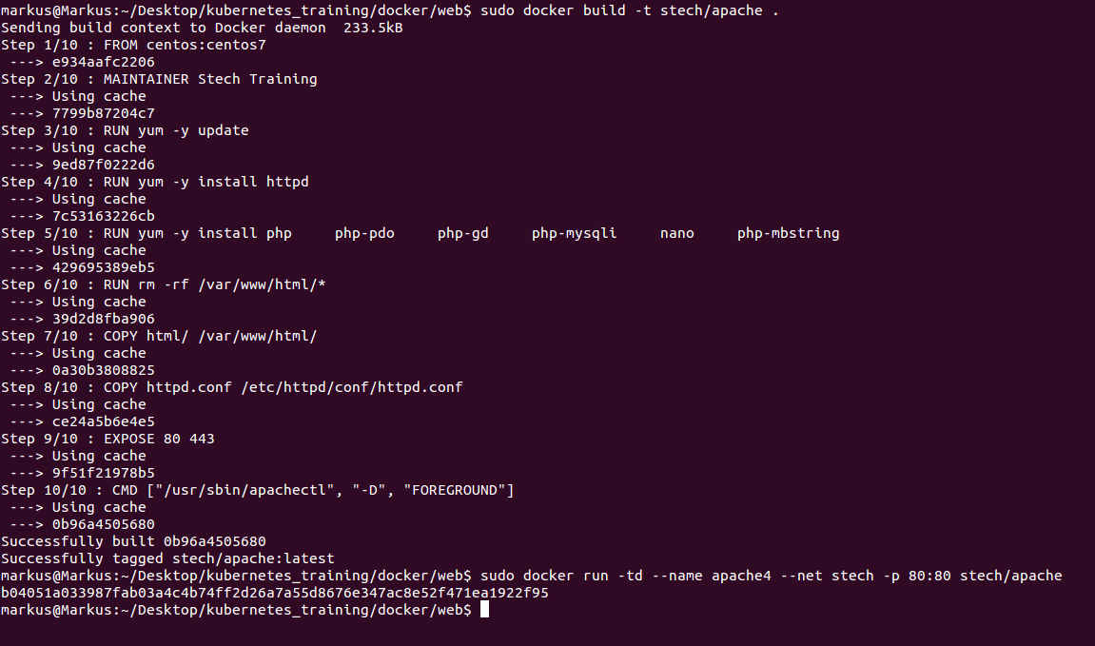
Container Creation
$Docker build –t stech/apache .

Slide 22
How is my information stored?
On the Host!
File level Storage – Storage to the OS or application in the form of files / directories.
Block level storage- Raw volumes of storage are created and each block can be controlled as a separate hard drive and managed by a server OS
We’re not going to get into too much detail of the difference between the two. But for now, let’s know by default, the Community installs overlay2, a file level storage.

Slide 23
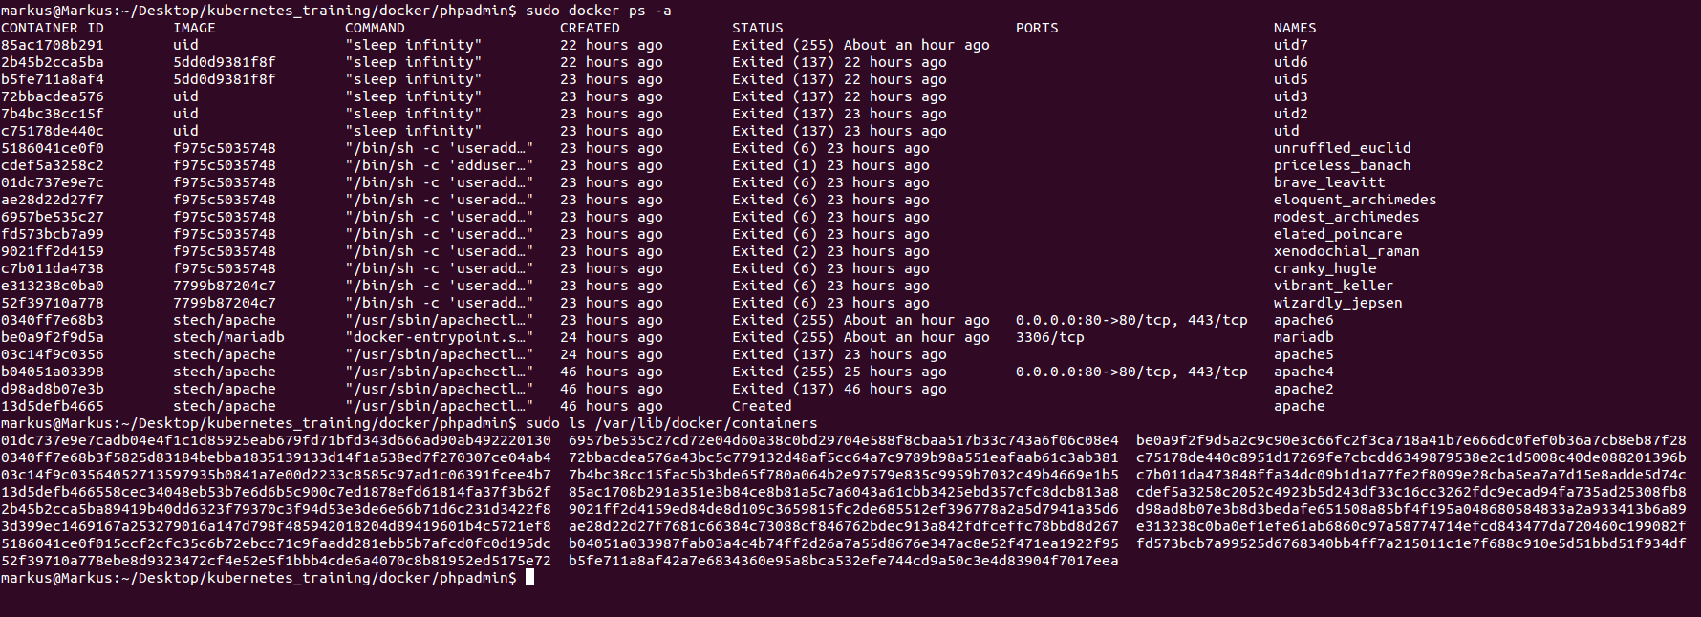
Where’s my containers?
/var/lib/docker/containers
/var/lib/docker/containers

Slide 24
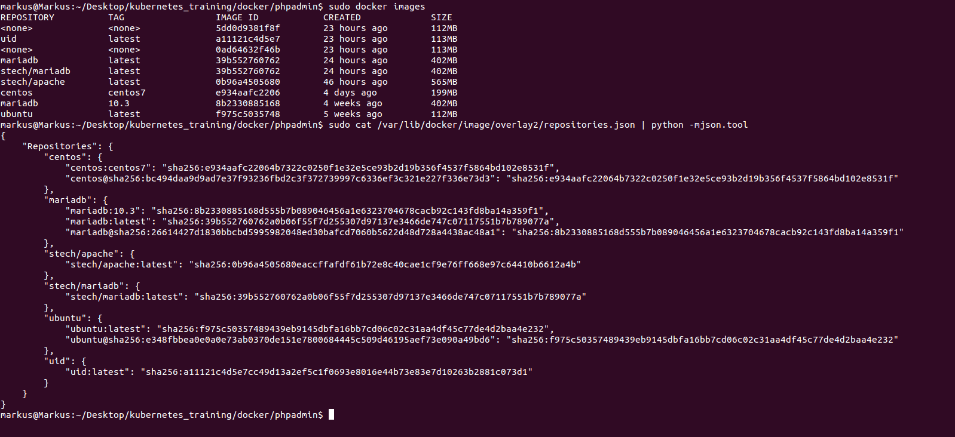
What about my images?
/var/lib/docker/image/overlayy2/repositories.json
The contents of the file is formatted into json

Slide 25
Networking in Docker
By default, docker includes support for networking through the use of network drivers.
Bridge
Overlay
You can connect your container to many networks as you like!
Networks are the most natural way to isolate containers from each other in Docker

Slide 26

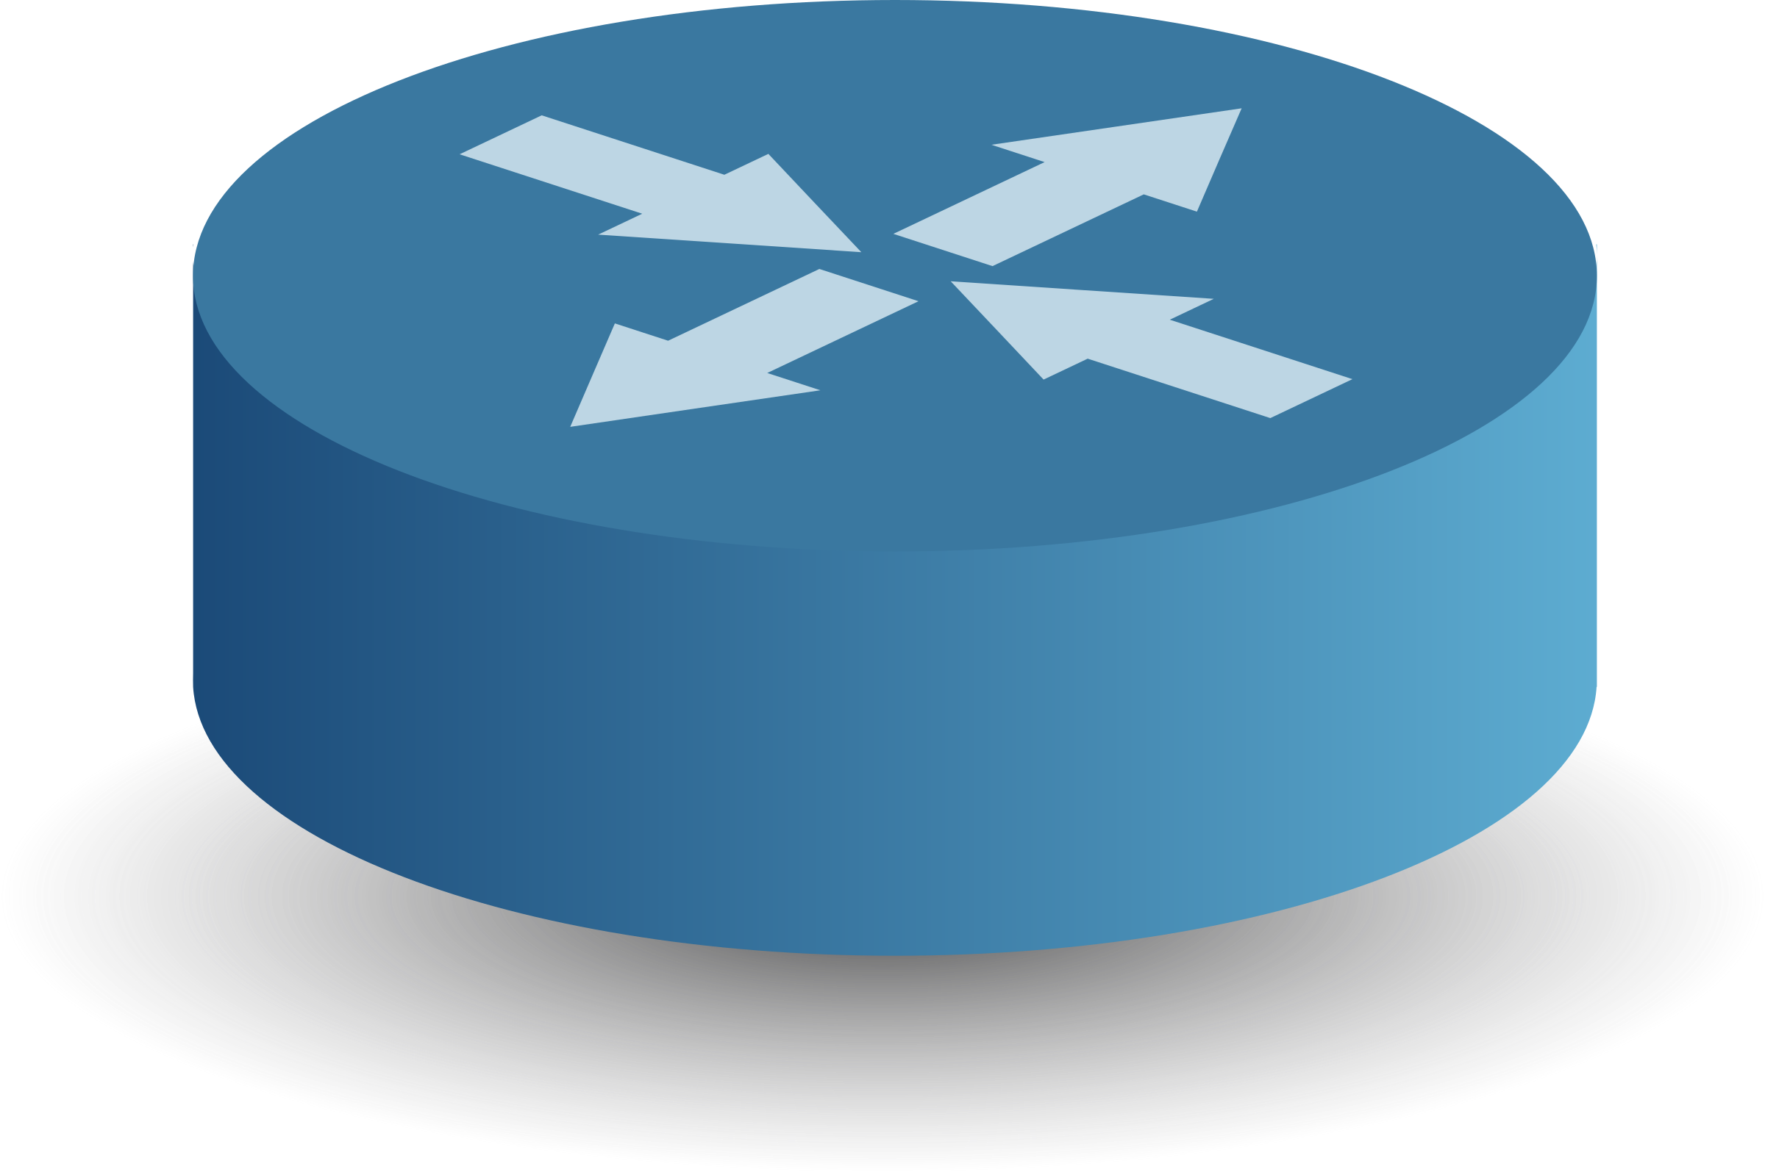
Containers in your network
HOST
Web
DB
Eth0:172.18.0.2
Eth0: 172.18.0.3
vethaf533
vethb039
Bridge – docker0
172.18.0.1
Eth0: 192.168.0.2

Slide 27

Docker networking =/= Kubernetes networking
Docker has the ability to create it’s own networking by default when connecting containers
Kubernetes handles it differently.
We’ll get into how Kubernetes handles It later in the class!

Slide 28

Who Owns My Container??!?

Slide 29
UID
A user ID, or UID, is an integer assigned by the Unix OS to each user.
Without any flag or option, a container will execute as root, unless a different UID was supplied in the dockerfile
Remember, the docker container shares a single kernel with the host, that means all of the UID’s is controlled by it.

Slide 30
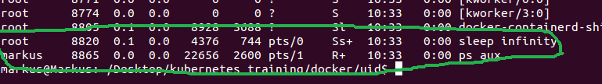
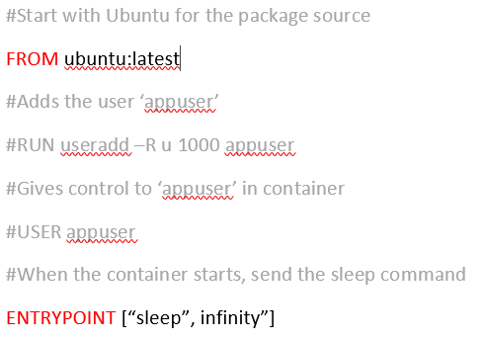
Root User
Root was able to run the command ‘sleep ‘ inside of the container.
By default, unless otherwise changed, docker containers will run as root

Slide 31
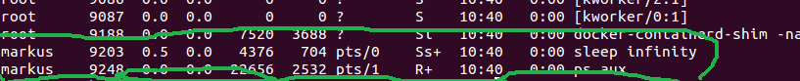
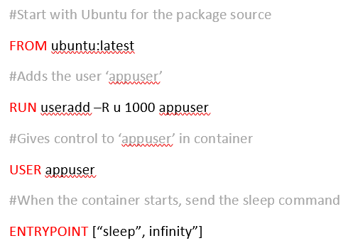
Normal user
In this instance, within the container the user ‘markus’ is running the sleep command as opposed to root.
If an existing UID that the process inside the container is running as, it could be as simple as restricting access to the host system so that the UID within the container has limited access

Slide 32
Concerning?
Of Course!
Your container has root privileges.
Once your container is compromised, your host has potential to be as well.
Like earlier, remember, the host and the container share the same Linux kernel.
Be cautious on what applications you are running in your containers and how/what root is being used for.
Kubernetes d0es allow you to prevent containers from running as root as a Pod Security Policy (more on this later)

Slide 33
Docker Lab
https://github.com/sealingtech/kubernetes_training
SSH into your machine
Hostname: Student<#>.kubernetes.lab
Username: root
Password: kubernetesx3
Install Docker
Create Docker containers
Apache
MariaDB
Access your webserver

Slide 34
Kubernetes Overview

Slide 35
Kubernetes
Pretty much the coolest thing in the world

Slide 36
What is it?
Docker aims to deploy and run software more efficiently creating containers
Kubernetes manages the infrastructure around it
Compute
Storage
Networking
Serves as an abstraction to a lot of the underlying technology, I care less about how my packets get there just that they get there
Designed to be highly scalable, many of Kubernete’s concepts come from Borg which runs Google’s infrastructure

Slide 37
Changes in architecture thinking
Often we first would scale architectures up first and then out only if we needed to (add CPUs, memory, etc)
Kubernetes promotes scaling out first
Aim to build applications which serve a very small and finite purpose and work together as part of a larger architecture (micro-services)
Design applications to be as “stateless” as possible, this means we don’t care if individual applications fail
Some applications need to be stateful, we have ways to deal with that as well

Slide 38
Kinds
Won’t be covering in class
Deployment
Stateful Set
Daemonset
Will be covering in class
Deploys and manages a version of pods
Replicaset
Job
Cron Job
Deploys multiple pods
POD
Provides network access to other pods
Legacy.. Replaced with Deployment/Replicaset
Service
Replication
Controller
Container(s)
Allows external access
Node
Runs on
Provides storage
Ingress
Volume
Used for long term storage
Provides a way to distribute sensitive data
Provides configurations
To containers
Volume
Persistent Volume Claim
Secret
Configmap

Slide 39
What is a Pod?
Remember that containers consist of only one process?
Here is how we can get around that in Kubernetes
Containers are deployed inside of pods, pods can contain multiple containers
Share networking, storage and more
This can be used to deploy dependent containers that will be scaled out together
Containers can communicate over localhost, cutting down on network traffic
POD
Container(s)
Persistent Volume Claim
Networking/
Localhost

Slide 40
Pod design patterns - Sidecars
Two containers which provide services to one another.
Can share volumes to provide data transfer
Provides modularity and simpler design of each

Slide 41
Pod design patterns - Ambassadors
Proxy communication out to the rest of the world
Often will buffer data before the data is sent out to another service on the cluster

Slide 42
Pod design patterns - Adapters
Often used for formatting data or buffering data before being picked up by another service
Can share data between containers with localhost or shared volumes

Slide 43
What is a Deployment?
Deployment
Deployments are meant to deploy multiple version of the same set of Pods
When deploying new software, it will create a new replicaset as it sunsets the old replicaset. This is to support roll back
Replicasets then deploy one or more copies of pods across the cluster
Replicaset
Old version
POD
POD

Slide 44
What is a Service?
Pods are meant to move, be created, die. Networking is shifting all the time
When pods need to communicate they must go through services
Pods can be load balanced through services
Services get their own IP addresses, these are dynamically assigned but then remain constant between versions of pods
Services also get a DNS entry served through kube-dns

Slide 45
Simplified and slightly incorrect view of a service
Network
Node 1
Node 2
Kube-Proxy
Kube-Proxy
Traffic load balanced to all pods in replicaset
Client Pod
Server Pod
Server Pod

Slide 46
Note about networking and storage
Kubernetes doesn’t provide this!
Kubernetes relies on networking (called container networking interfaces) and storage plugins
Kubernetes provides a standard way of configuring the networking and storage and abstracts the underlying details away from the application and developers
Some available CNI plugins
Flannel
Calico
OpenVswitch
Contrail
NSX-T
Some available storage plugins
CEPH
GlusterFS
Cloud provider specific
NFS

Slide 47
Ingress
Kubernetes pods live in their own world on the network and can communicate out through NAT, the outside world can’t communicate with containers inside of it.
Ingress provides external access to the rest of the world
Kubernetes again, only configures… you need a plugin
Often integrates with load balancers or reverse proxies

Slide 48
How do I get Kubernetes?
Cloud providers
Google Kubernetes Engine
Microsoft Azure
Amazon Elastic Container Service
Kubeadm – Deploy your own Kubernetes Cluster
Minikube – for small deployments on your local workstation
Openshift – Kubernetes supported by Red Hat Offering
CoreOs – Kubernetes supported, recently bought by Red Hat
I do things the hard way! https://github.com/kelseyhightower/kubernetes-the-hard-way

Slide 49
How do I manage Kubernetes?
Kubectl on a users workstation is how you manage the cluster
Uses SSL to communicate with the cluster
Configuration files and secure keys are stored in ~/.kube/

Slide 50
Structure of kubectl commands
kubectl <verb> <kind> <sometimes specific object>
Verb - what you want to do
kind– all those object types I mentioned before
If you are referring to an object sometimes (like a specific pod) you need this
Examples:
kubectl get pods – displays all pods
kubectl describe pod <name of pod> - Gives all the details of a pod

Slide 51
Understanding YAML
Generally you create everything in Kubernetes using yet another markup language (YAML) files
YAML is space sensitive use two spaces instead of tabs!!!!
By using files, you are allowing your infrastructure to be version controlled and repeatable
Can add comments with the # sign
kubectl apply –f <apply the configurations of a YAML>

Slide 52
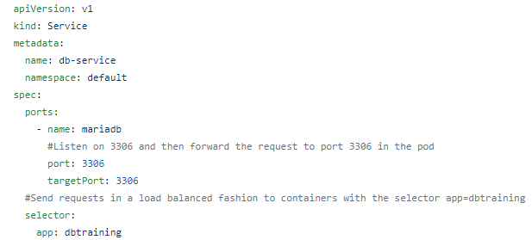
Sample YAML
apiVersion – As the specifications change, so do the options. To maintain backwards compatibility you specify version of the spec
Kind – what it is you are configuring
Metadata – Used to reference the object from other YAMLs
Spec- All the nitty gritty details

Slide 53
Other terms to know
Node – Bare metal or VM host hosting pods
Master – A special node that hosts all cluster management services
Minion - !Master
Kubelet – Service which manages every node
Namespace – Allows for multiple tenants to use a single cluster. You are using the default namespace unless you indicate otherwise.
Kube-system – An important namespace that is used to manage the entire cluster and everything in it

Slide 54
Kube-system Pods
Kubectl get pods --namepace=kube-system
Other than the kubelet, everything else is pods!
Kube-apiserver – exposes the Kubernetes API
Etcd – Provides coordination of settings across the entire cluster through key-value pairs
Kube-scheduler – decides where pods will be placed when built
Kube-controller-manager – manages nodes, replication, endpoints, service accounts
Kube-proxy – handles networking with service Ips between pods and load balancing between pods
Kube-DNS – provides DNS throughout the cluster so pods can find services
Web-UI (optional) – provides a GUI for command line adverse people

Slide 55
Kubernetes Lab 1
Install Kubeadm
Install Kubectl
Deploy a single node cluster
Install Calico Networking
Install Traefik for Ingress
View components of a Kubernetes Cluster

Slide 56
Kubernetes Lab 2
Deploy pods with containers we created earlier
Deploy services to allow pods to talk
Deploy Ingress to allow outside access
Perform a rolling update

Slide 57
Resources
Github - https://github.com/docker
Docker Hub – https://hub.docker.com/
Docker - https://www.docker.com/

